Slide 1
REDUX

Slide 2
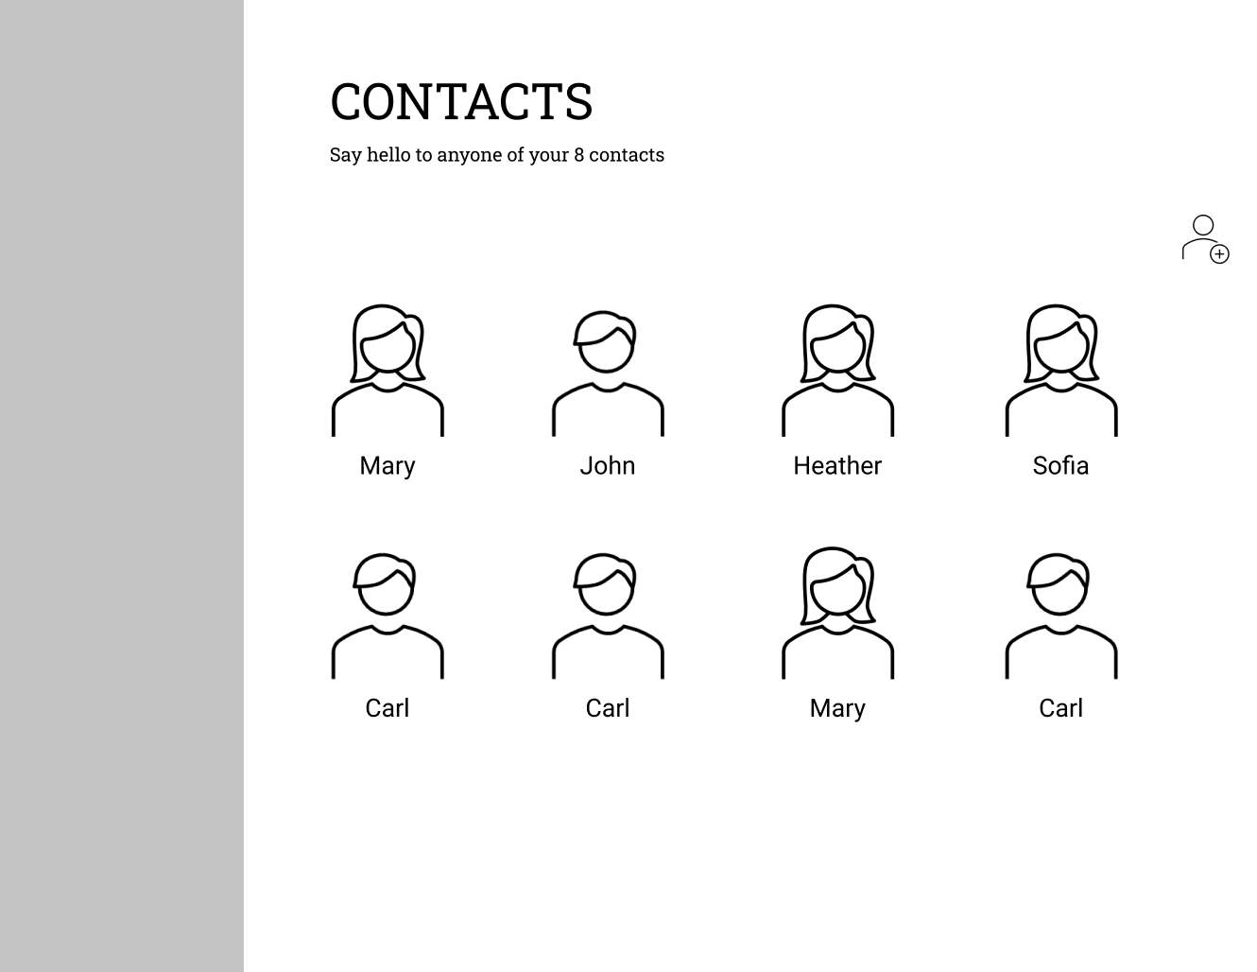

Slide 3
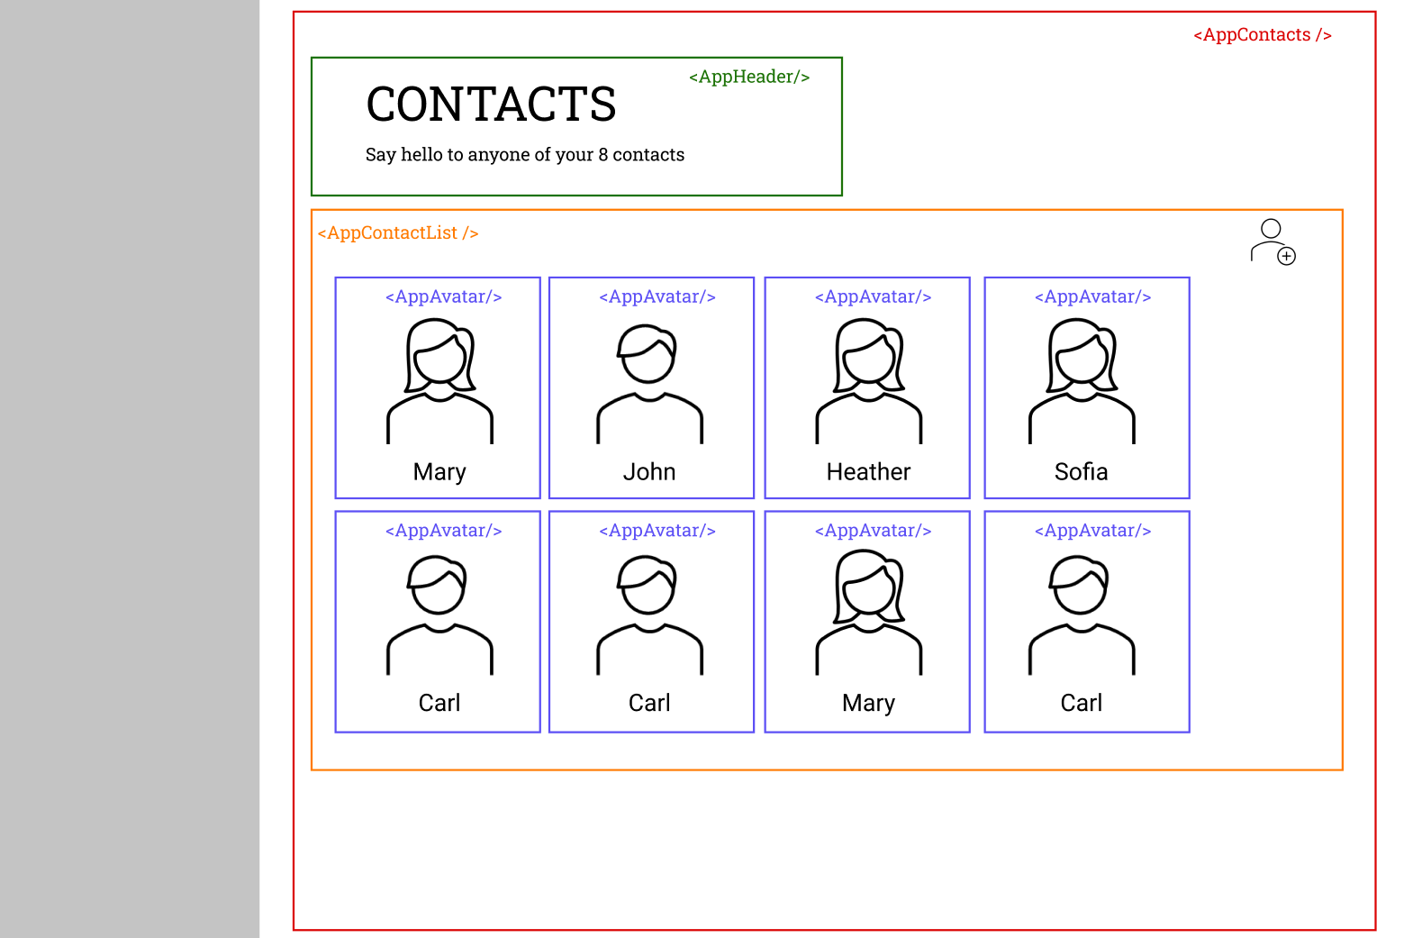

Slide 4
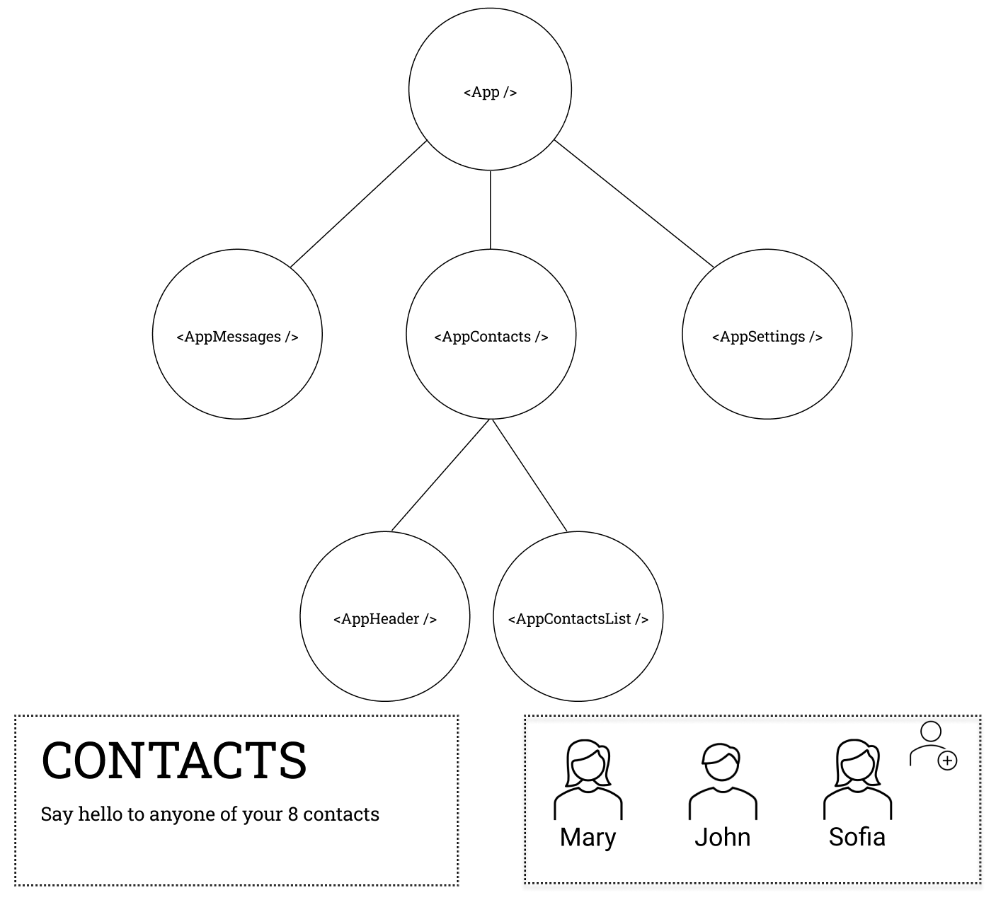

Slide 5
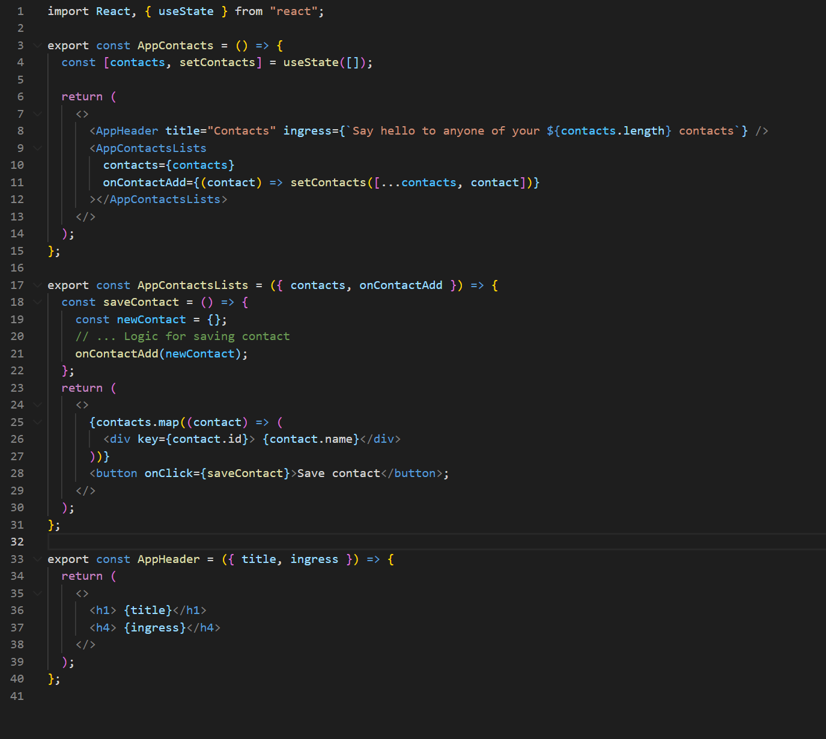

Slide 6
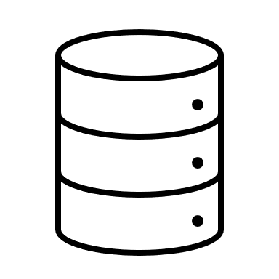

Slide 7
Actions
State
View
Notes:
How does React handle updates/re-renders It is a self-contained app with the following parts:
The state, the source of truth that drives our app;
The view, a declarative description of the UI based on the current state
The actions, the events that occur in the app based on user input, and trigger updates in the state
One way data flow
State describes the condition of the app at a specific point in time
The UI is rendered based on that state
When something happens (such as a user clicking a button), the state is updated based on what occurred
The UI re-renders based on the new state

Slide 8
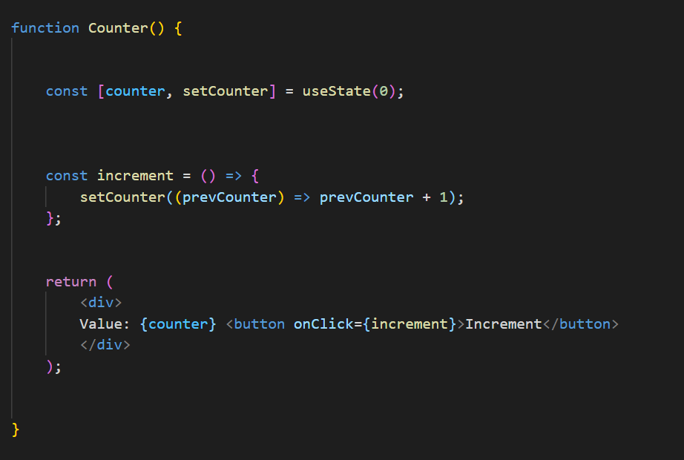
State
Action
View

Slide 9
Overview
Global state is stored in an object tree within a single store.
Only way to change the state tree is through actions.
Actions are objects describing what happened.
Actions must be dispatched to the store.
Reducer functions handles the actions and updates the state.
Only reducers can update data in the store, which ensures that state is only updated in a predictable fashion.
Reducers can must not mutate state

Slide 10
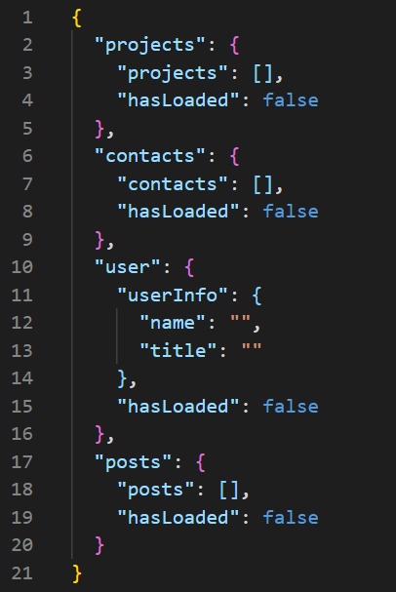
STORE
ACTIONS
DISPATCH
REDUCERS
Notes:
Simple JSON tree structure

Slide 11
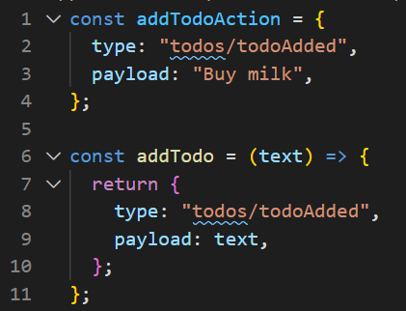
STORE
ACTIONS
DISPATCH
REDUCERS
Notes:
An action is a plain JavaScript object that has a type field and optionally a payload. An actions describes something that happened in the application.
Normally type is written as “domain/eventName”, where domain points to the feature or category and eventName the events that happened.
On on th eimage we see both an action and action creator. Action creators makes sure that you do not have to write the type every time.

Slide 12
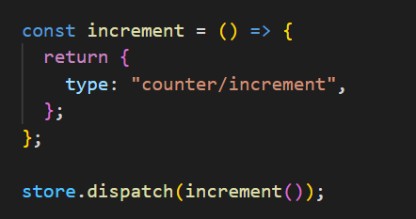
STORE
ACTIONS
DISPATCH
REDUCERS

Slide 13
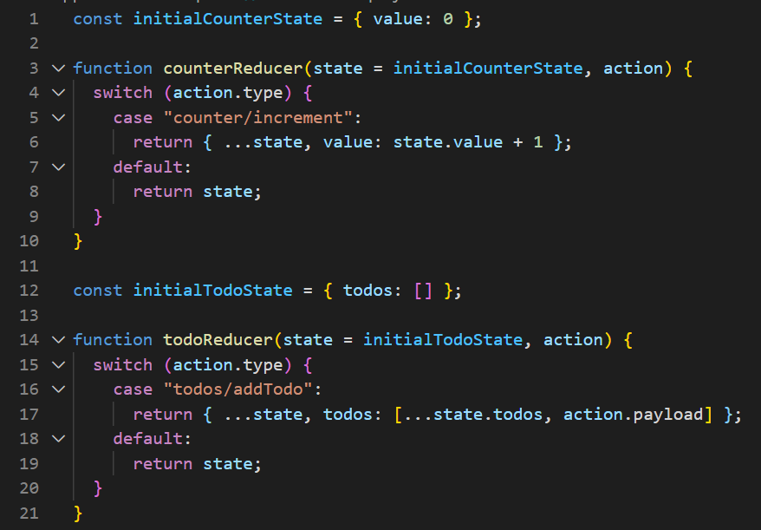
STORE
ACTIONS
DISPATCH
REDUCERS
Notes:
A reducer is a function that receives the current state and an action object, decides how to update the state if necessary, and returns the new state: (state, action) => newState. You can think of a reducer as an event listener which handles events based on the received action (event) type. Reducers must always follow some specific rules:
They should only calculate the new state value based on the state and action arguments
They are not allowed to modify the existing state. Instead, they must make immutable updates, by copying the existing state and making changes to the copied values.
They must not do any asynchronous logic, calculate random values, or cause other "side effects"
The logic inside reducer functions typically follows the same series of steps:
Check to see if the reducer cares about this action
If so, make a copy of the state, update the copy with new values, and return it
Otherwise, return the existing state unchanged

Slide 14
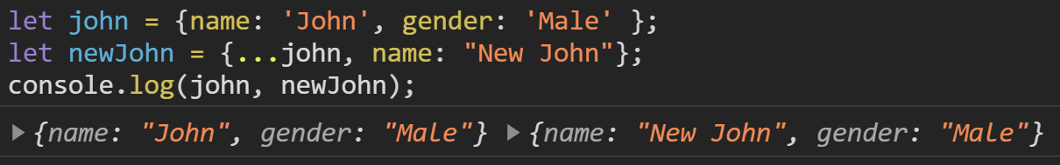
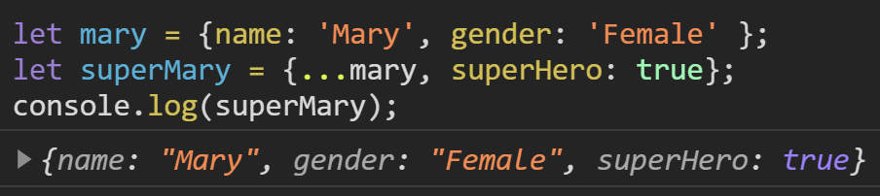
STORE
ACTIONS
DISPATCH
REDUCERS
Notes:
A reducer is a function that receives the current state and an action object, decides how to update the state if necessary, and returns the new state: (state, action) => newState. You can think of a reducer as an event listener which handles events based on the received action (event) type. Reducers must always follow some specific rules:
They should only calculate the new state value based on the state and action arguments
They are not allowed to modify the existing state. Instead, they must make immutable updates, by copying the existing state and making changes to the copied values.
They must not do any asynchronous logic, calculate random values, or cause other "side effects"

Slide 15
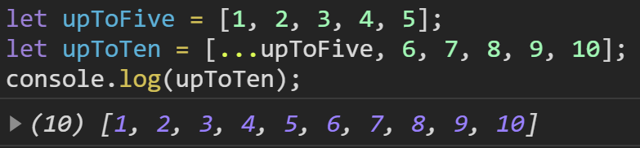
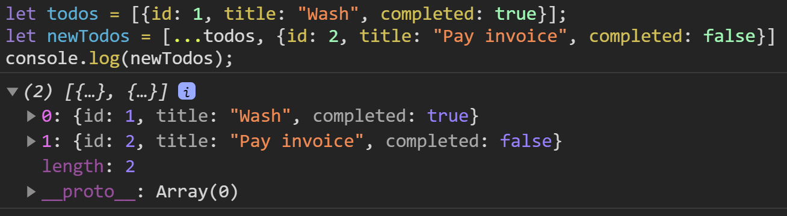
STORE
ACTIONS
DISPATCH
REDUCERS

Slide 16
STORE
ACTIONS
DISPATCH
REDUCERS

Slide 17
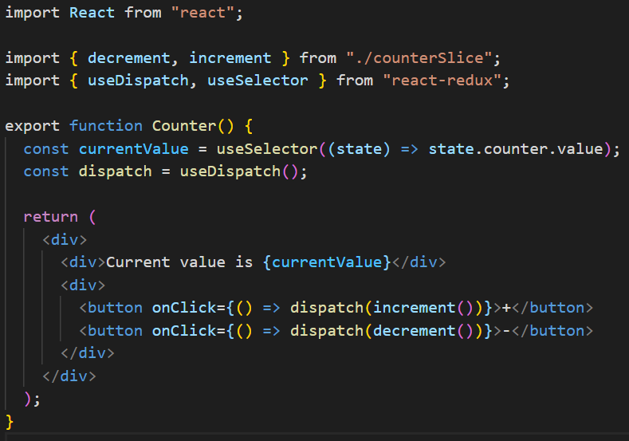
Notes:
Each component can use useSelector to subscribe to values.
Each component can use useDispatch to dispatch actions. Hooks are functions that let you “hook into” React state and lifecycle features from function components.

Slide 18
Actions
State
View
Notes:
How does React handle updates/re-renders It is a self-contained app with the following parts:
The state, the source of truth that drives our app;
The view, a declarative description of the UI based on the current state
The actions, the events that occur in the app based on user input, and trigger updates in the state
One way data flow
State describes the condition of the app at a specific point in time
The UI is rendered based on that state
When something happens (such as a user clicking a button), the state is updated based on what occurred
The UI re-renders based on the new state

Slide 19
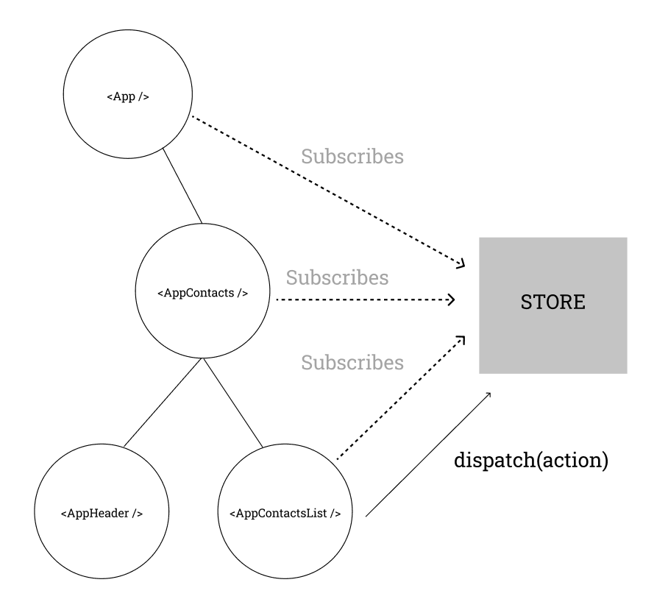
Notes:
Something happens in the app, such as a user clicking a button
The app code dispatches an action to the Redux store, like dispatch({type: 'counter/increment'})
The store runs the reducer function again with the previous state and the current action, and saves the return value as the new state
The store notifies all parts of the UI that are subscribed that the store has been updated
Each UI component that needs data from the store checks to see if the parts of the state they need have changed.
Each component that sees its data has changed forces a re-render with the new data, so it can update what's shown on the screen

Slide 20

Source: https://redux.js.org/tutorials/essentials/part-1-overview-concepts

Slide 21
THUNKS
Requires middleware called Redux-Thunk.
Already set up if you use Redux-Toolkit.
Will check if the action is a function or not. Given function it will call that function with the dispatch parameter as first value. Dispatch will then be available when the async function returns.
Notes:
A thunk is a specific kind of Redux function that can contain asynchronous logic. Thunks are written using two functions:
An inside thunk function, which gets dispatch and getState as arguments
The outside creator function, which creates and returns the thunk function
However, using thunks requires that the redux-thunk middleware (a type of plugin for Redux) be added to the Redux store when it's created. Fortunately, Redux Toolkit's configureStore function already sets that up for us automatically, so we can go ahead and use thunks here.

Slide 22
But Redux is hard…
Immutable updates
Having to
Configure store
Register reducers
Create and dispatch actions
Subscribe to changes
…. lots of boilerplate code to wire everything up correctly.
To address these issues the team behind Redux has created Redux Toolkit.

Slide 23
Redux Toolkit
CreateSlice() which greatly reduces the amount of boilerplate code.
CreateSlice uses Immer which allows to due “mutable” updates.
Not really mutable update.
Beware: This cannot be done in any given reducer without proper setup, e.g. by using Immer.
Simplifies Store setup
Setup with
Thunks support
Redux DevTools

Slide 24
Provider
Setting up store.
How can every component have access to the store-object?
I did not tell how.
Notes:
We always have to call ReactDOM.render(<App />) to tell React to start rendering our root <App> component. In order for our hooks like useSelector to work right, we need to use a component called <Provider> to pass down the Redux store behind the scenes so they can access it.

Slide 25
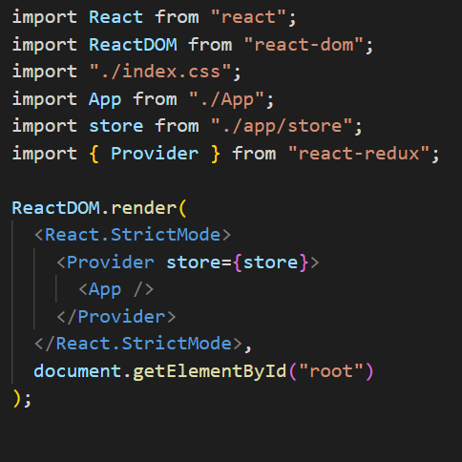
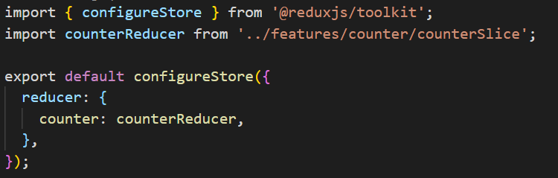
Index.js
store.js
Notes:
We always have to call ReactDOM.render(<App />) to tell React to start rendering our root <App> component. In order for our hooks like useSelector to work right, we need to use a component called <Provider> to pass down the Redux store behind the scenes so they can access it.

Slide 26
CODE

Slide 27
When to use
You have reasonable amounts of data changing over time
You need a single source of truth for your state
You find that keeping all your state in a top-level component is no longer sufficient

Slide 28
Should all data be in the store?
The answer is NO. Global state that is needed across the app should go in the Redux store. State that's only needed in one place should be kept in component state.

